Slide 1
Amazon CLONE
52. Amitesh Patil
54. Kshitij Patil
56. Pranit Patil
77. Vivek Pundkar

Slide 2
Introduction
It’s a great idea to start your own ecommerce platform. But it required a lot of manpower, enough time as well as capital to develop it from scratch.
Amazon is a vast Internet-based enterprise that sells books, music, movies, housewares, electronics, toys, and many other goods.
Amazon is the self-styled “Greatest Store on Earth”. It’s been said that Amazon aim is to sell everything to everyone
As buyers differ in their need, wants, their buying behaviour and attitude. Amazon take care of all these by providing over 80 million products, which are categorized into 35 departments.
OVER; 6 million → Clothing department, 20 million → Sports & outdoors, 4 million → office products, 20 million → Electronic, 25 million → books,

Slide 3

PROBLEM STATEMENT
We aim to make an amazon clone which is similar to the original amazon web,
We will focus more on the look and feel as it is clone application, i.e. it should be more similar to https://www.amazon.in/
In here we also aimed to create virtual card transactions and purchase listed items.
Our clone will allow users to register, login, add products to the shopping cart, remove product from the shopping cart. Our clone will permit only an authenticated user to access the home page.

Slide 4
BLOCK DIAGRAM
Homepage
Checkout
Payment
On Click basket
Header
Header
Header
Proceed to Checkout
Products
Subtotal
Basket
Footer
Overview product
Total
Footer
Payments method
Footer

Slide 5
Requirements
Software Required:
Virtual Studio code
Firestore
Stripes
Programming Languages:
HTML
CSS
JAVASCRIPT
Tools:
Bootstap
Express
Node.js
Material UI icons
Carousal

Slide 6
KEY points
Project Setup
→ create-react-app amazon-clone → cd amazon-clone → npm start
Setting up Firebase
→Add name to project → enable Google Analytics → enable Email authentication
Connect our project to firebase
→ Install firebase in project → Add firebase.js file in source folder → Add firebase Config

Slide 7
Hooks
Hooks are a new addition in React 16.8. They let you use state and other React features without writing a class. Examples- useState & useContext hooks
Context API
Context provides a way to pass data through the component tree without having to pass props down manually at every level.
Creating Components
→ Header, Home, Login, Footer, Payment, Product, Subtotal etc into source folder
For Payment
→ Create server folder → Import stripes → add stripe secret test key into environment

Slide 8
featureS
Web application more-over similar to Amazon clone
Our clone will permit only an authenticated user to access the specific pages.
Register, Login, Add Products to the shopping cart, Remove Product from the shopping cart.
Will use Stripe’s software and APIs to accept payments.
Google pay and Pay pal components are also established in payment section
Speed
Simplicity
Good image resolution
Flexibility

Slide 9
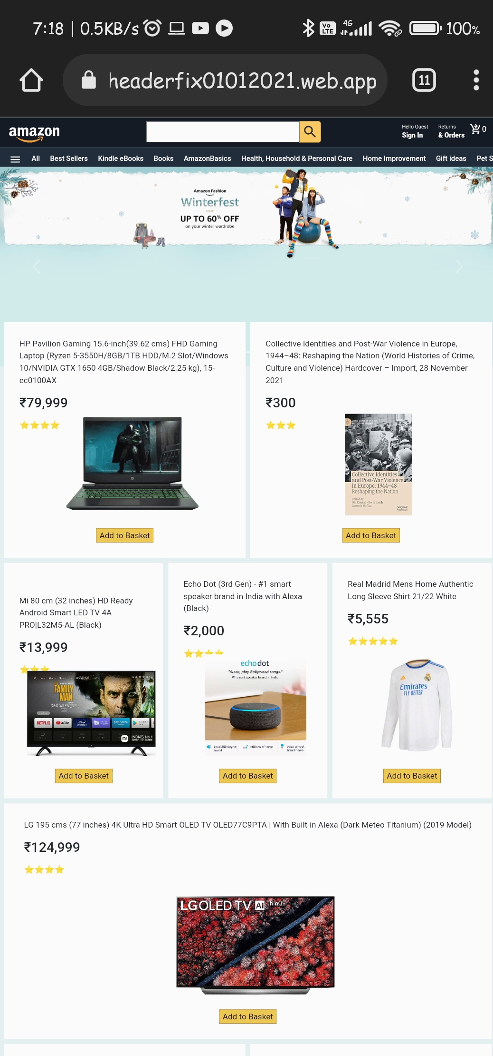
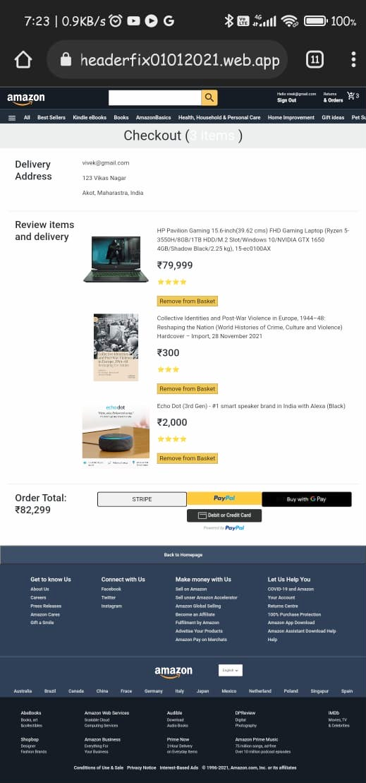
OUTPUT
Deployed URL:
https://project-2337871910416723419.web.app/
https://headerfix01012021.web.app/
https://clone-de.web.app/

Slide 10
Conclusion
All the functionalities are working properly.
Deployed an Amazon Clone react JS app on firebase.
We learned about different components of React and also learned about different CSS syntax.
This project helped us in developing our skills in domain of web development. We got to know about various features of firebase.

Slide 11




References
To Import packages: npmjs
To User Interface: material ui
Payment: stripe
https://www.amazon.in/
https://stackoverflow.com/

Slide 12



